Slide 1
Le Droit Park Transportation Package

Slide 2
Background
Neighbors across LeDroit have been dealing with many transportation related issues over the years with no great success. Small victories, such as changing the enforcement time of zone parking or temporarily filling potholes, are isolated to individual blocks when many of the same issues are being felt by the entire community.
Identifying transportation concerns and addressing them all together can streamline the bureaucratic process, ensure proposed resolutions don’t negatively impact another block, and promote regulation and enforcement continuity in the community.

Slide 3
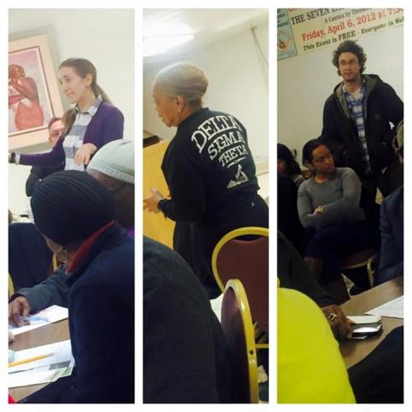
Community input
The “LeDroit Park Transportation Package” was developed by:
Performing a block-by-block assessment of transportation issues;
A call for community input through email;
Listening to neighbors priorities at the LeDroit Park Civic Association’s community forum on March 24, 2015; and
A final vote by the community at the LeDroit Park Civic Association's monthly general body meeting on April 28, 2015 to approve those incorporated recommendations.

Slide 4
Index
Findings from block-by-block assessment of LeDroit Park:
Parking Zones
Potholes
Sidewalks and Curbs
Community Concerns
Elm Street Parking Lot
Confusing Signage at 6th and U Street
Signage for Pets
Pedestrian Walkway
Summary of Recommendations

Slide 5
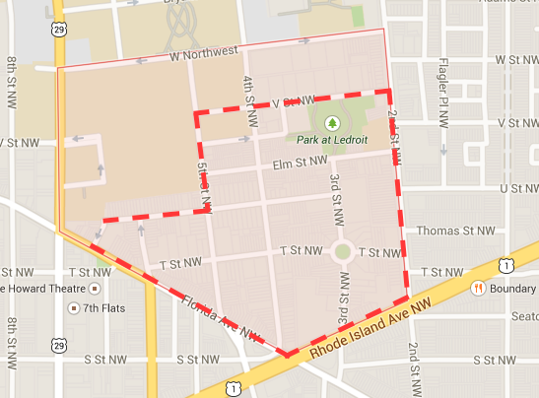
Parking in le droit
There are 49 stretches* of parking and 8 stretches* with no parking within the LeDroit Park boundaries.
*A stretch is one side of the street the length of one block. For example, the North side of T Street between 4th and 5th is one stretch.

Slide 6
Parking Zones
The issue: Parking after work hours and during weekends is difficult due to multiple zone availability and hours of enforcement.
Hours of enforcement for zone parking: 82% of zone and 2 hour parking is enforced between 7am and 8:30pm Monday through Friday. As a result, many out of state vehicles are parked for days at a time during the weekend.
Limited available parking is shared with other zones: 69% of all parking is shared with other zones and/or with general public for 2 hour periods. As a result,
Number of stretches restricted to zone parking only
Zone 1 | 15
Zones 1 and 5 | 11
Zones 1 and 2 | 2
Number of stretches with zone parking and 2 hour parking available to general public
Zones 1 and 5 with 2 hour | 10
Zone 1 with 2 hour | 8
Zones 1 and 2 with 2 hour | 2
Zones 1 and 6 with 2 hour | 1

Slide 7
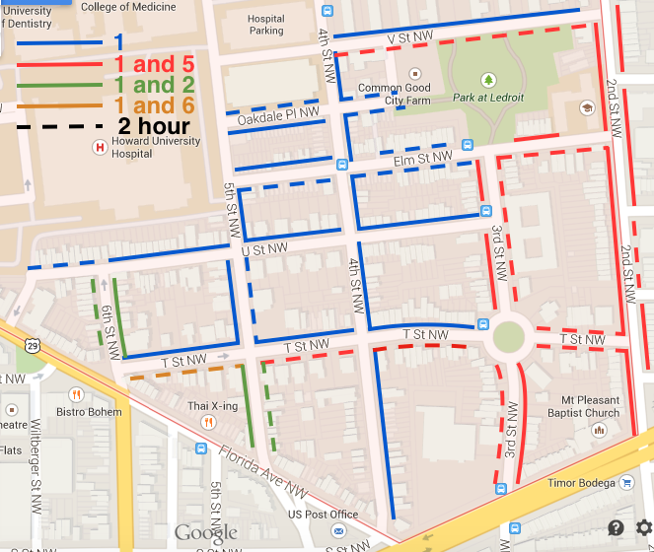
Parking Zones

Slide 8
Parking Zones - Recommendation
Expand enforceable hours for all “Resident Permit Parking Only” locations to Monday through Sunday from 7am to Midnight. This will ensure parking is available during evenings and weekends when our mostly residential community is in most need of parking.
Outline parking areas with white boarders in order to assist drivers with identifying appropriate locations.
Eliminate shared zone 5 parking on all east/west streets. Currently in Ward 5, parking is not shared nearly as frequently as in Ward 1. This change would bring a more equitable parking situation as it would directly mirror the shared zoning situation between Flagler and 2nd Street, Adams and Thomas Street. The impact would be on 7 stretches, majority of which are on T Street. The result would be a 33% reduction of zone 1 and 5 parking, which includes 2 hour parking that exempts both zones 1 and 5.

Slide 9
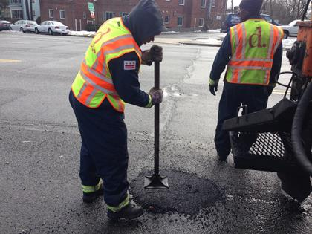
potholes
The issue: fixes to potholes are not permanent which leads to larger and deeper potholes.
4th Street: the greatest number and the largest, deepest potholes in the community were located on 4th Street between Florida Avenue and V Street.
Intersections: With the use of various materials at certain intersections, potholes develop in the concrete and bricks become dislodged or go missing.

Slide 10
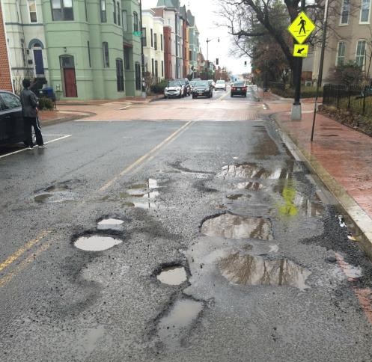
Potholes – 4th Street
4th Street between U and Elm (south view)
T Street and 4th Street (north corner)

Slide 11
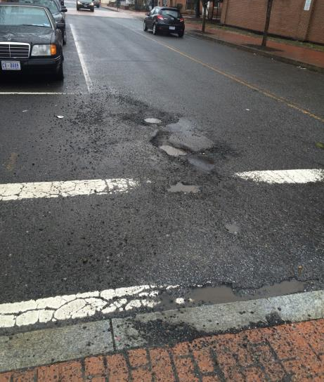
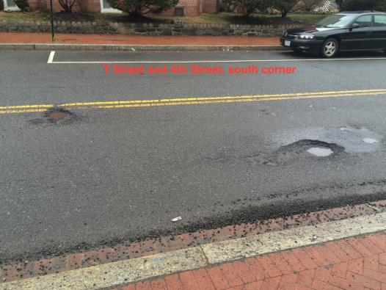
Potholes – 4th Street
V Street and 4th Street (north corner)
T Street and 4th Street (south corner)

Slide 12
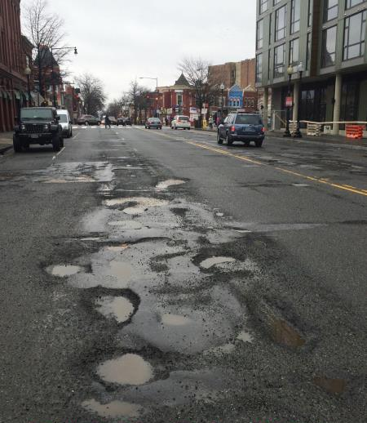
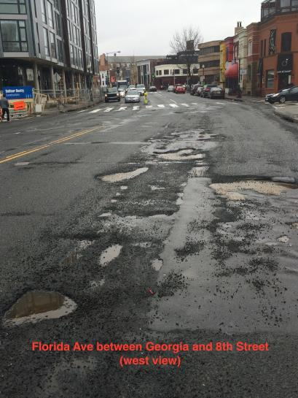
Potholes – Florida Ave
Florida Ave and 8th Street (east view)
Florida Ave and 8th Street (west view)

Slide 13
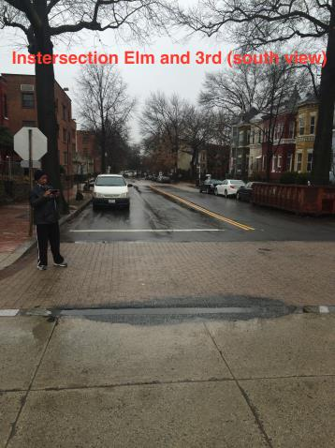
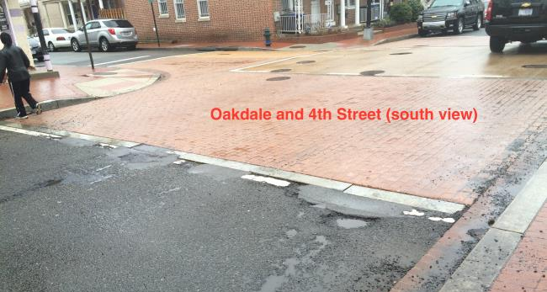
Potholes - intersections
Elm and 3rd Street (south corner)
Oakdale and 4th Street (north corner)

Slide 14
potholes - Recommendation
Place 4th Street on the list for a “Resurfacing.” Using DDOT’s Pavement Conditions Index (PCI) presentation from July 2014 before Councilwoman Cheh*, the following images suggest that 4th Street is in a “Failed” or “Very Poor” state. The stretch between Florida Avenue and V Street is 0.3 miles , which is priced out at $300,000 per mile.
Place a “Truck Restriction” on 4th Street between Florida Avenue and V Street, as seen on DDOT’s Truck and Bus Through Routes and Restrictions Map. This would prevent commercial vehicles over one ton from traveling on 4th Street, thus reducing unintended wear and tear and noise.
*www.washingtonpost.com/blogs/mike-debonis/wp/2014/07/09/the-lousy-state-of-d-c-s-streets-explained-in-14-slides-and-two-charts/

Slide 15
Sidewalk and Curbs
The issue: dislodged and missing bricks in the sidewalk, curbs, and gutters are not only an eyesore but negatively impact public safety.
Here is a running list of missing bricks as of April 20, 2015
T Street at the corner of 4th Street
Roughly at the addresses of 1805, 2021, and 2038 4th Street
Oakdale between 4th and 5th Street
Entrance of Park at LeDroit (corner of Elm Street and 3rd Street)
Roughly at the address of 1907, 1919 and 1961 3rd Street
Roughly at the address of 216, 315 and 345 Elm Street
2nd Street at the southwest corner of V Street
Other sidewalk concerns: missing ground cap at 1819 4th Street

Slide 16
Unkempt parking lot
The issue: behind the north row of house on the 300 block of Elm Street, a small parking lot has not been maintained.
Lack of maintenance: without regular upkeep, large amounts of trash have accumulated, bulk waste has been dumped, and bushes and weeds are overgrown.
Deteriorating signs have encouraged confusion of who can park there.
Abandoned or non-operating vehicles have been parked for extended periods.

Slide 17
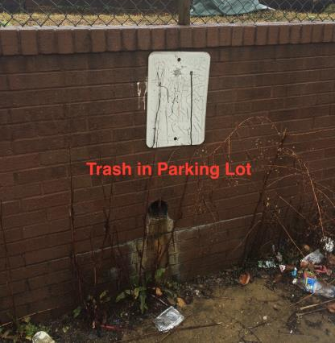
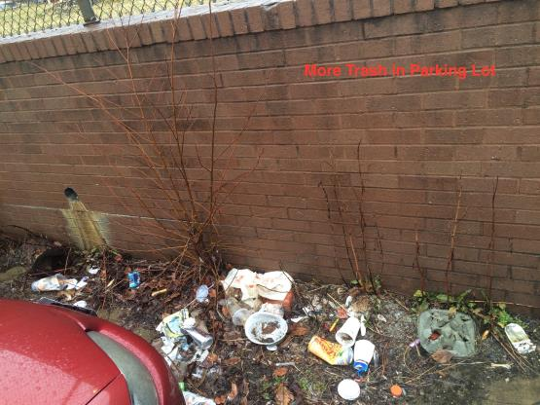
elm street parking lot
Trash and unkempt signage
More trash

Slide 18
elm street parking lot
More trash and over grown weeds

Slide 19
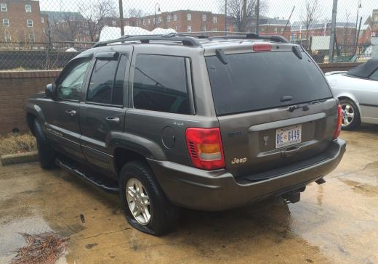
elm street parking lot

Slide 20
Unkempt parking lot - Recommendation
Clean the lot by removing abandoned vehicles, all remaining trash, and bushes and weeds. Additionally, replace signage.

Slide 21
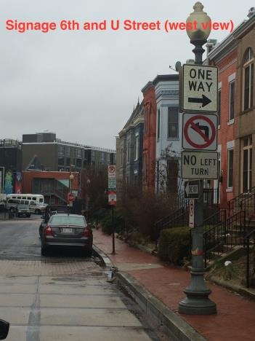
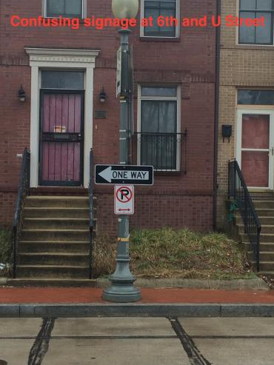
Confusing Signage
The issue: signs indicating one way streets at the corner of 6th and U Street are confusing and misleading
west view
east view
West bound is one way, but going east is 2 way.

Slide 22
Confusing Signage - Recommendation
Remove over abundance of signs and place “pavement markings” of traffic arrows on 6th Street just as vehicles approach U Street.

Slide 23
Signage for pets
Pedestrian
walkway
The issue: neighbors have expressed difficulty crossing over 4th Street at U Street due to the volume and speed of traffic. This is particularly concerning for parents residing on the 400 block of U Street where roughly 6 children all under the age of 2 live.
The issue: neighbors across LeDroit have expressed concern over animal droppings being left behind, especially around the park .

Slide 24
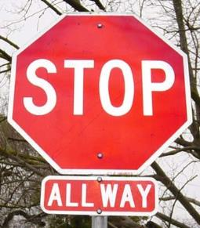
Recommendations
Signage for Pets:
Place more “Pick Up After Your Dog” signs around the Park at LeDroit, Anna Cooper Circle, and other strategically placed locations in the community.
Pedestrian Walkway
Place a 4 way stop sign at the intersection of 4th Street and U Street.

Slide 25
Recommendation summary
Expand enforceable hours for all “Resident Permit Parking Only” locations to Monday through Sunday, 7am to midnight.
Outline parking areas with “pavement markings.”
Eliminate shared zone 5 parking on all east/west streets.
Place 4th Street on the list for “Resurfacing.”
Place a “Truck Restriction” on 4th Street.
Clean the Elm Street parking lot.
Remove over abundance of signs and place “pavement markings” of traffic arrows.
Place more “Pick Up After Your Dog” signs around the Park at LeDroit, Anna Cooper Circle, and other strategically placed locations in the community.
Place a 4 way stop sign at the intersection of 4th Street and U Street.

